Slide 1
Energy Flow in the Biosphere
EcologyUnit Chapter 2

Slide 2
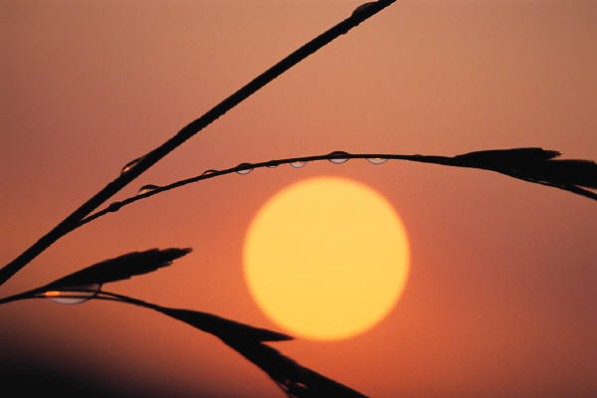
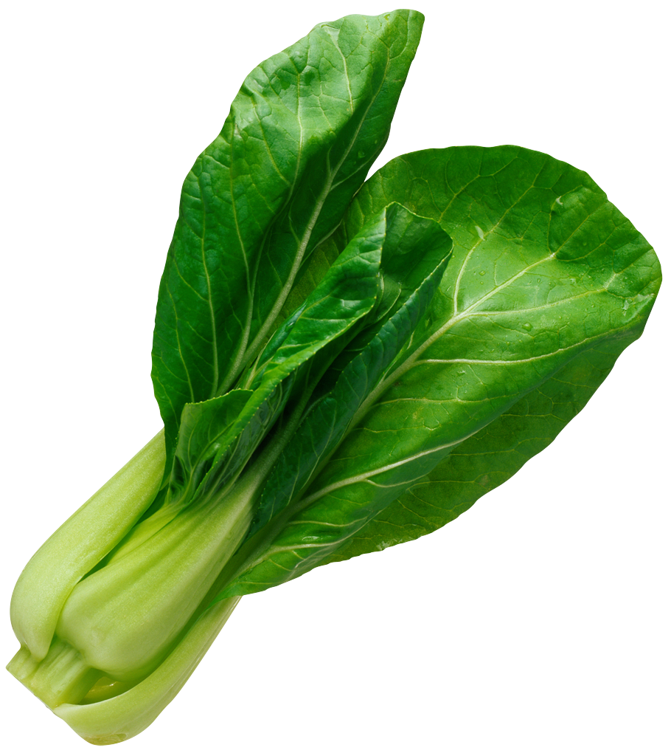
All Energy Originates From the Sun
Solar Energy allows for Photosynthesis
Solar energy becomes chemical energy (carbohydrate), chemical energy becomes mechanical (movement), potential (stored as fat) or radiant energy (heat given off).
Energy is passed through living organisms within ecosystems via food chains and food webs.

Slide 3
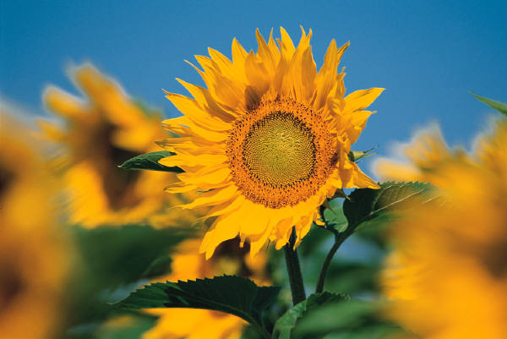
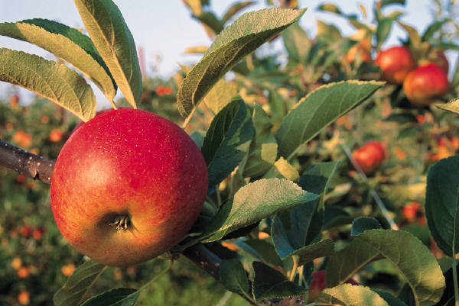
Autotrophs (self feeding)
Able to feed themselves via photosynthesis (using light) or chemosynthesis (using chemical)
Primary Producers (plants) use energy from the sun to convert non-living chemical nutrients into living tissue and high energy molecules of sugar and carbohydrate. This is where the suns energy is stored.

Slide 4
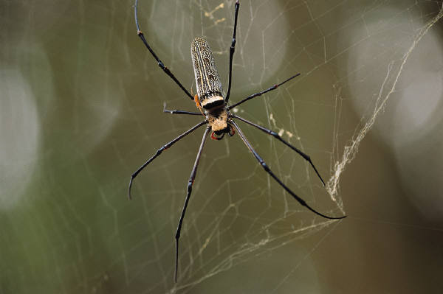
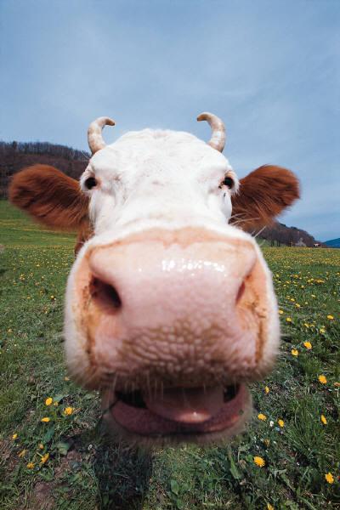
Heterotrophs (feeding from others)
Must feed on others for energy.
Primary Consumers = herbivores, eat plants only
Secondary, Tertiary, Quatenary Consumers
a. Omnivores eat plants and animals
b. Carnivores eat animal flesh primarily

Slide 5
Trophic Levels
Troph means to feed.
Trophic levels then are Feeding levels in food chains and food webs.
*First Order Consumers = herbivores & omnivores
*Second Order Consumers = omnivores or carnivores
*Third, fourth etc. comsumers = omnivores or carnivors

Slide 6
Limits to Food Chains
Trophic Levels are limited in natural ecosystems.
Why? - Only 10% (on avg.) of the available energy in one trophic level is passed from one trophic level to another.
100% 10% 1 %

Slide 7
Why So Little Energy Passed On?
It takes or “costs” energy to live.
ex. metabolism, tissue repair, growth, movement
Not all the energy in food can be used by the eater.
ex. DECOMPOSERS still thrive on breaking down and obtaining energy from animal an plant waste and dead tissue. (yuk!)
Microbes, bacteria, earthworms, scuds, beetles - all eat dead things, feces. If you compost at your house, you watch this happen all the time.

