Slide 1
Mitosis
Somatic (body) Cell Division

Slide 2
Mitosis: What is it?
The division of somatic (body) cells
Your cells age or get damaged. You also are still growing. Your cells need to multiply and create new, virtually identical, cells.
Gametes (eggs and sperm) are made in a different process called meiosis.

Slide 3
Mitosis is one giant circle
Mitosis is literally the “circle of life.”
Cells are constantly dividing or getting ready to divide.
Every minute, 300 million cells die in the human body. That sounds like a lot, but when you consider how many cells we actually have; it’s really just a fraction. It is estimated that we have 10-15 trillion cells in our bodies. Adults produce about 300 billion new cells every day. (Healthazoid.com)

Slide 4
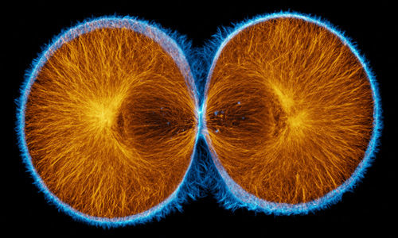
So, what’s the point?
Scientists are interested in how the DNA in one cell duplicates and then is split up. The cell divides into two and so the DNA is divided into two.
http://celldynamics.org/celldynamics/research/cytokinesis/index.html

Slide 5
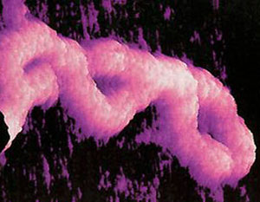
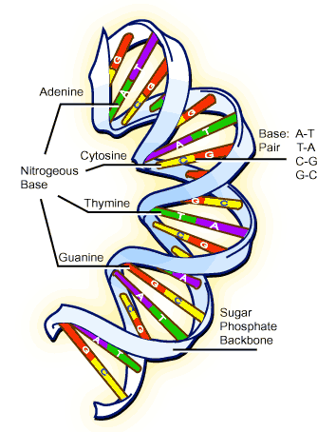
DNA is : deoxyribonucleoside. The atoms of nitrogen, oxygen, hydrogen, and phosphorous are arranged into a code. The code contains the instructions for your entire body.
http://science.kqed.org

Slide 8
Mitosis
We will take a very close look at how the DNA is divided up and where it goes. To give you an idea of what this looks like, here is short video.
http://barleyworld.org/sites/default/files/mitosis.swf

Slide 9
Other vocabulary
Genotype: all of your genetic material. All the genes you got from your parents.
Gene: A unit of heredity. A length of DNA that codes for some characteristic. Often, many genes determine an outcome. Example: hair color.

Slide 10
Chromosome: A single, very long, individual piece of DNA.
The long DNA molecules are complexed with proteins and coiled and folded into a structure known as a chromosome.
http://www.hhmi.org/biointeractive/dna/DNAi_packaging_vo2.html

Slide 11
How many chromosomes?
Humans have 23 pairs of chromosomes (22 pairs of autosomes and 1 pair of sex chromosomes)
23 X 2 = 46 chromosomes/cell.
http://www.hhmi.org/biointeractive/dna/DNAi_human_chromosomes.html

Slide 12
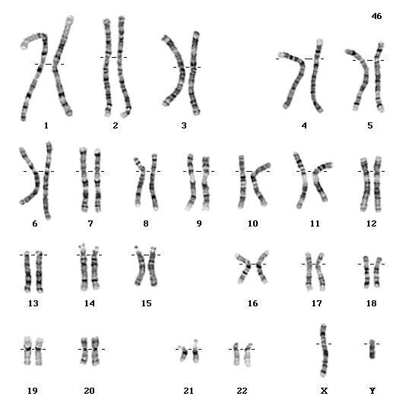

Slide 13
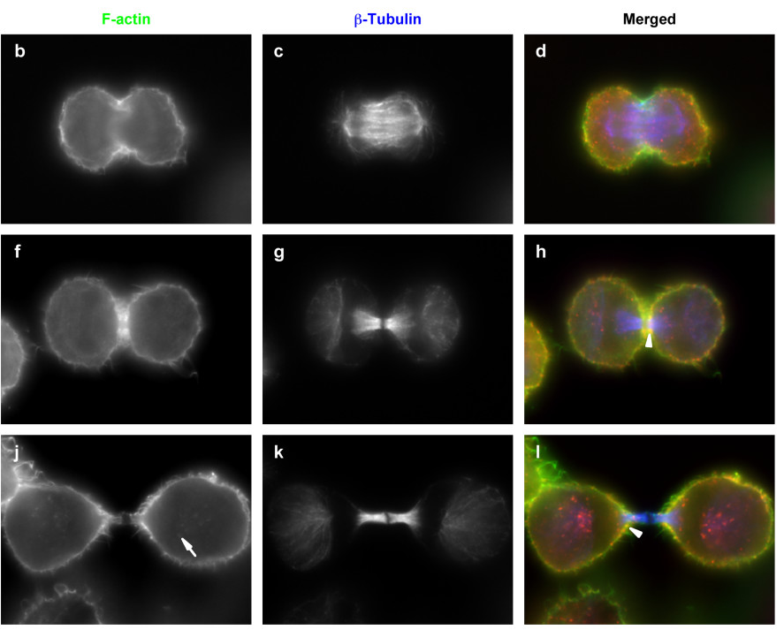
Biomedcentral.com

Slide 14
The Steps
Interphase
  G1
  Synthesis
  G2
Prophase
Metaphase
Anaphase
Telophase (and cytokinesis)
Once complete each new cell is in interphase

Slide 15
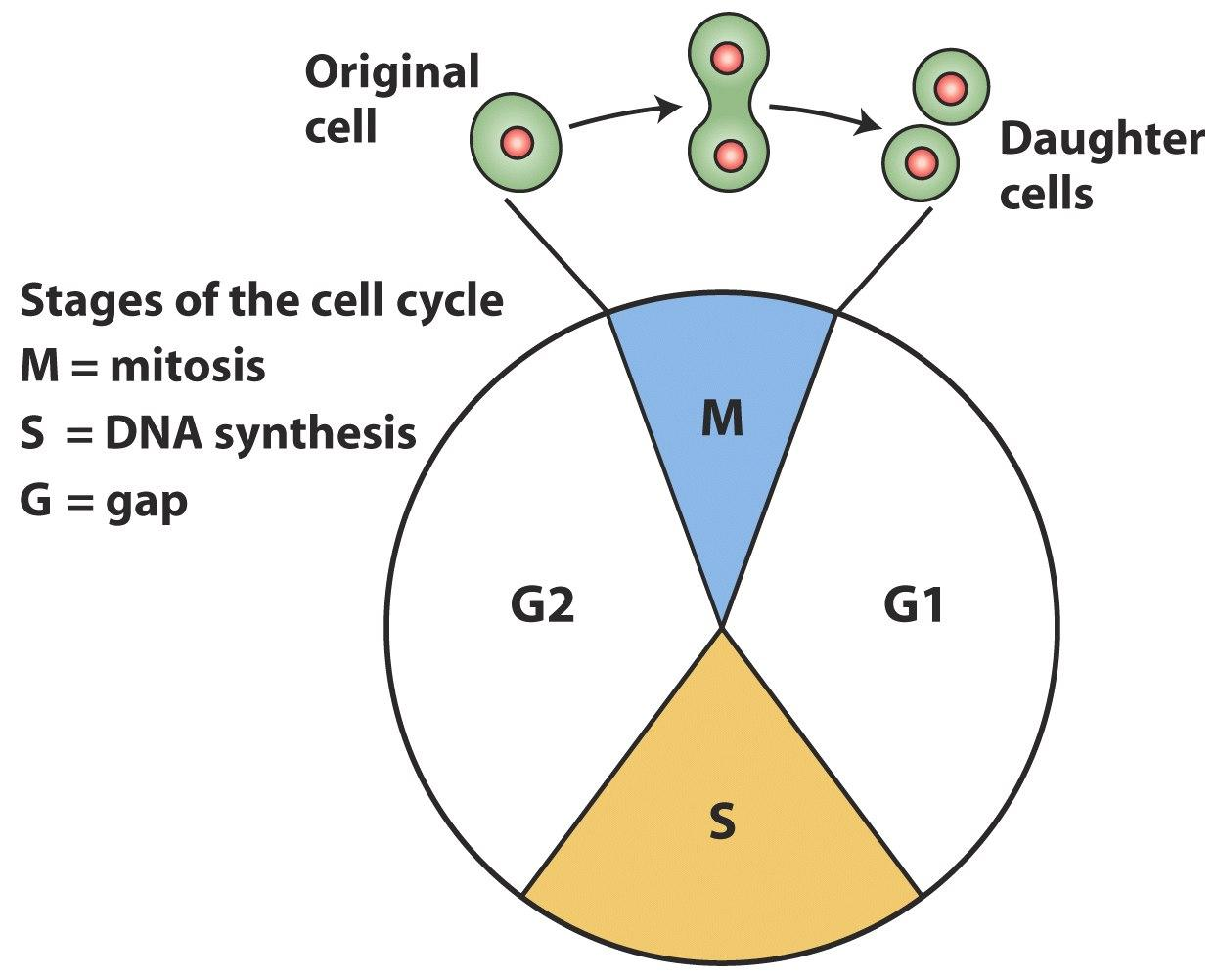
http://barleyworld.org/book/export/html/29

Slide 16
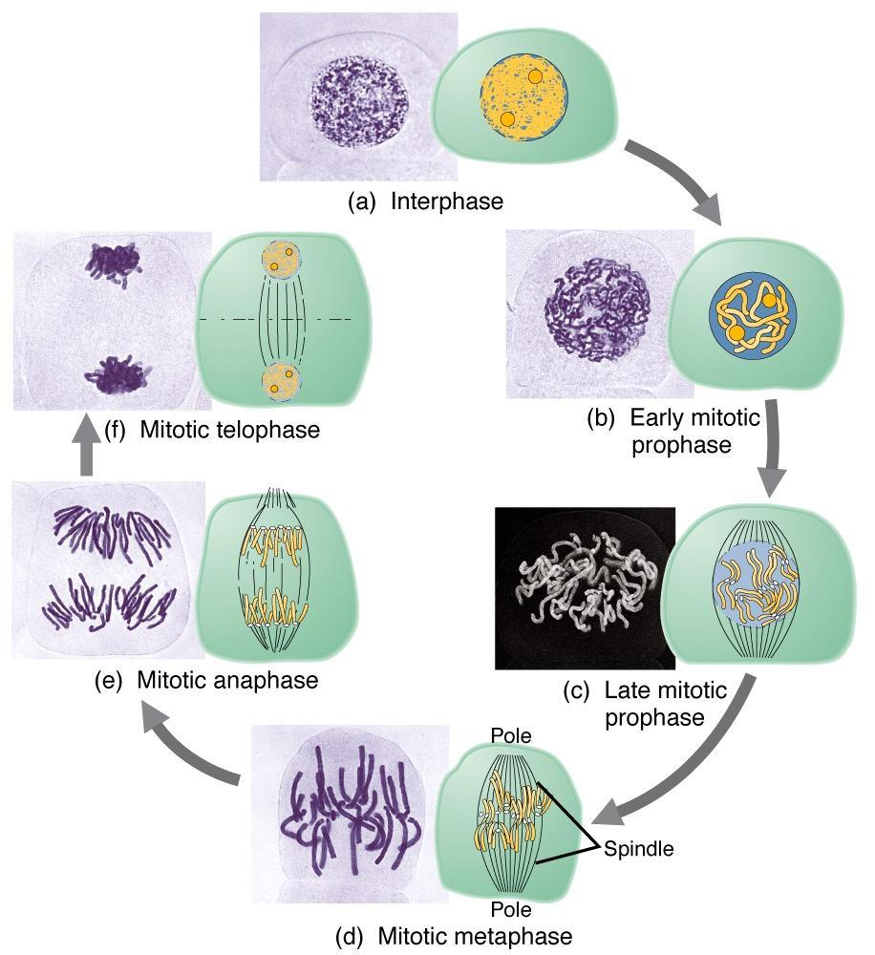

Slide 17
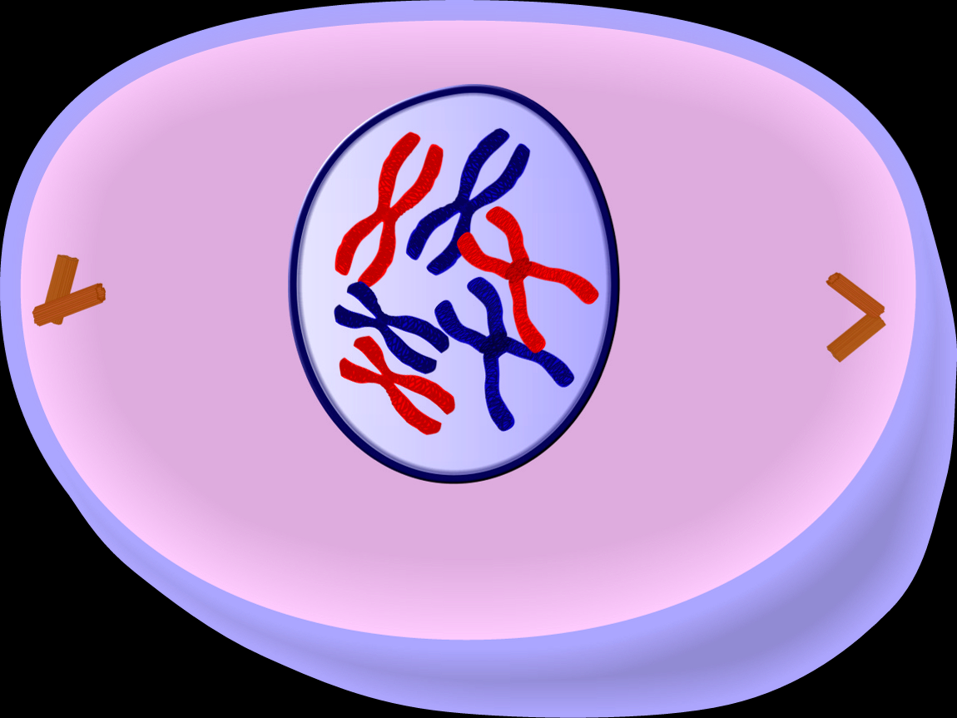
Prophase
http://www.edupic.net/cells.htm

Slide 18
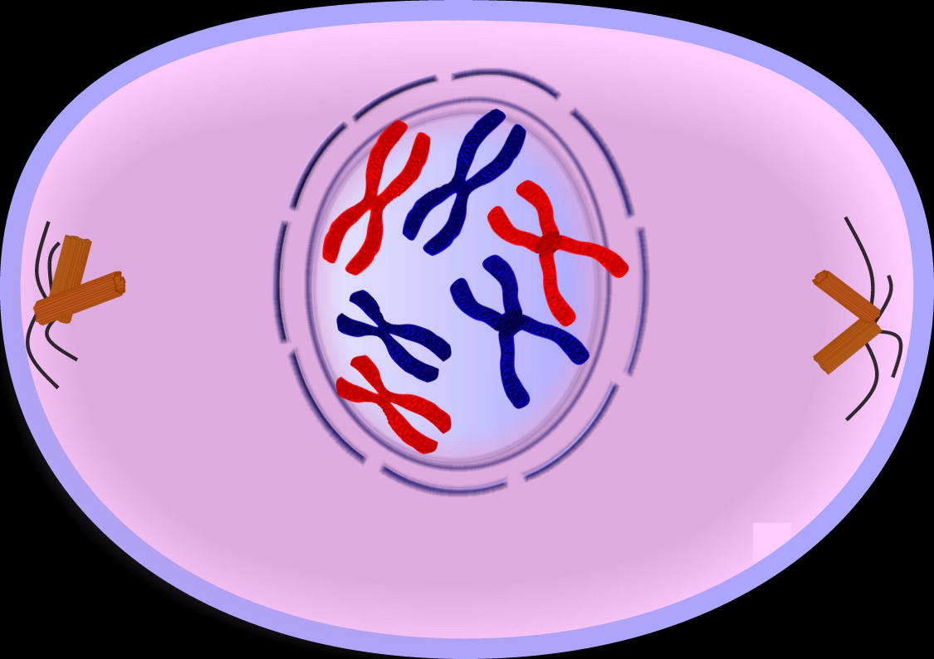
Prometaphase

Slide 19
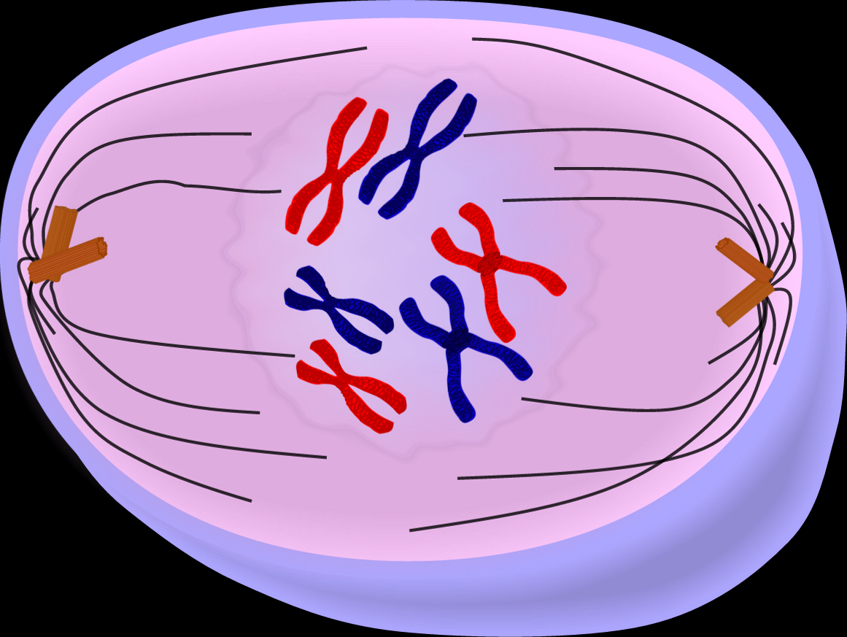
Metaphase

Slide 20
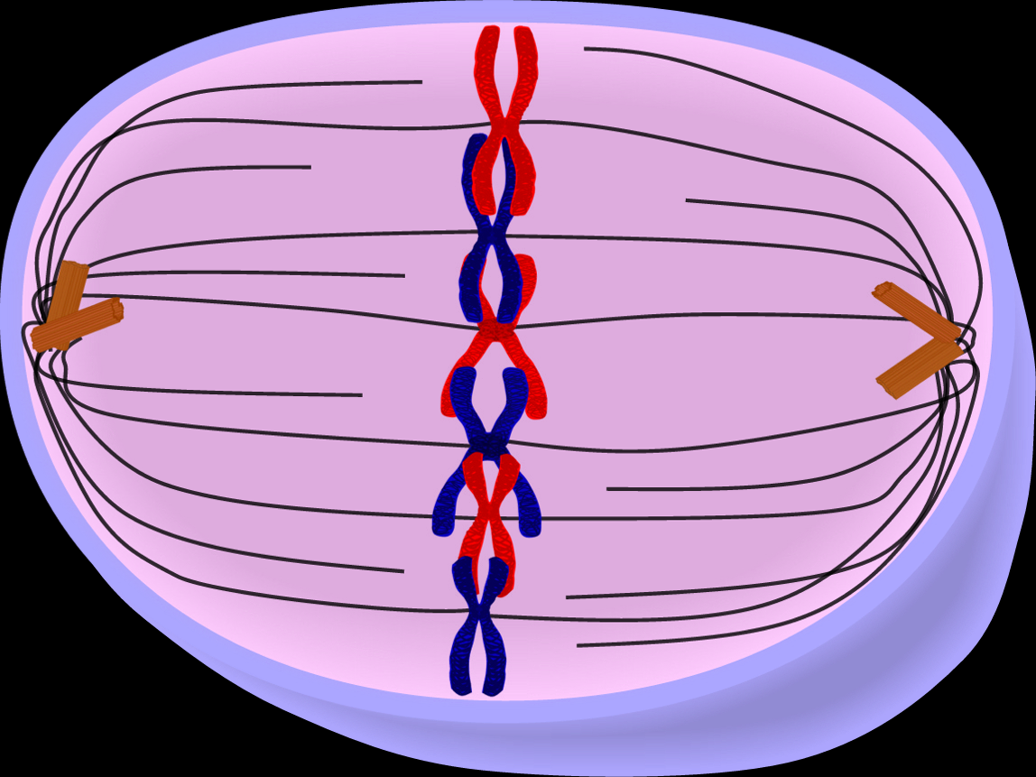
Metaphase

Slide 21
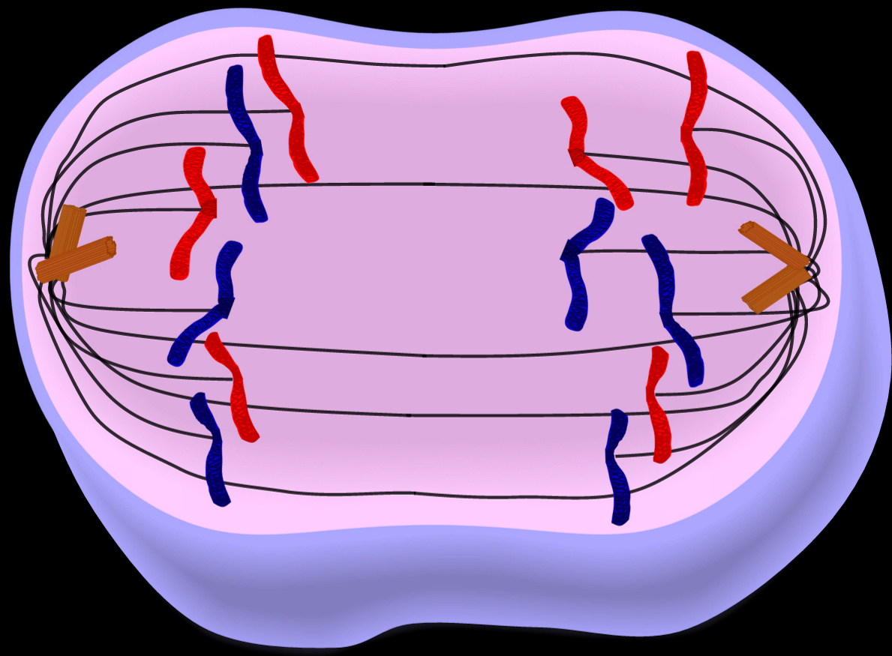
Anaphase

Slide 22
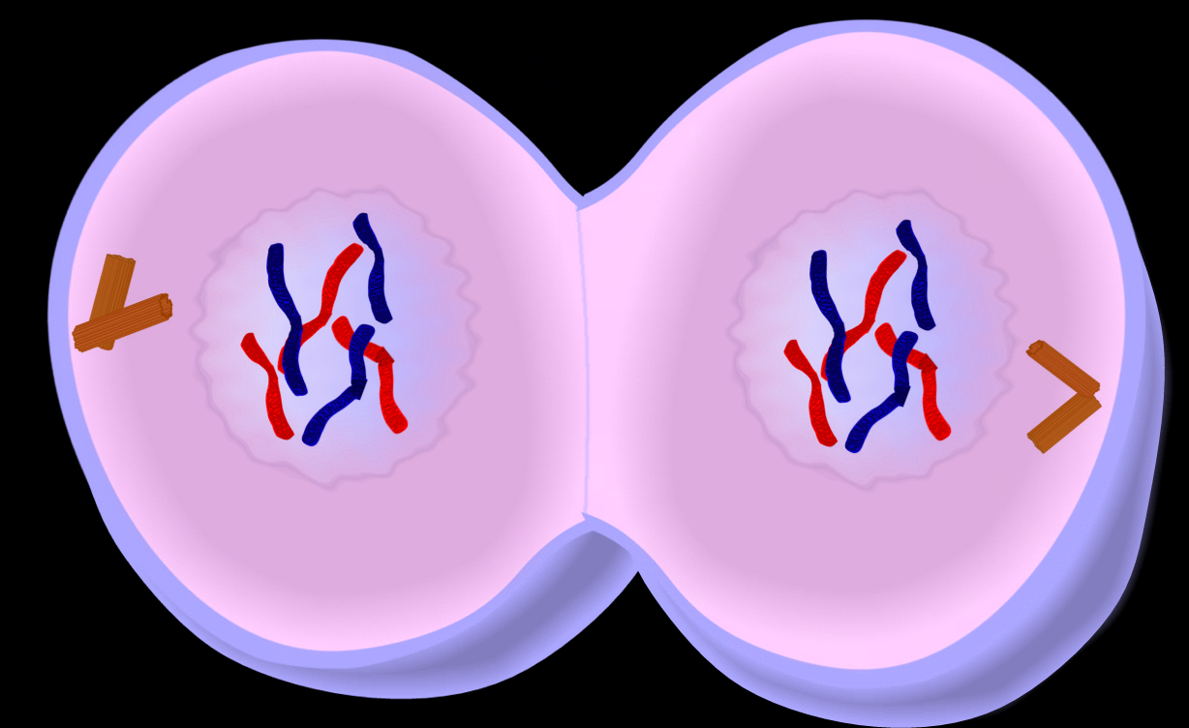
Telophase

Slide 23
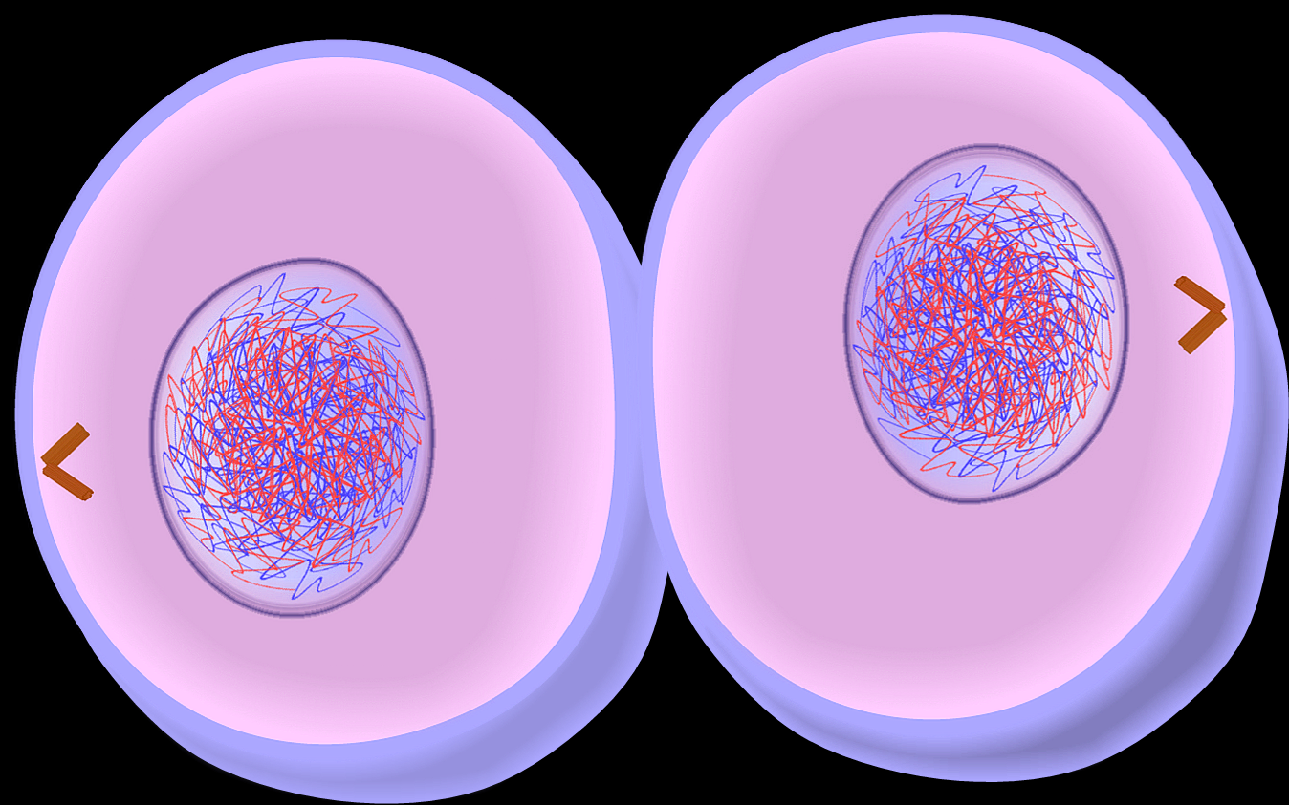
Two cells in interphase

Slide 24
Synthesis
So, DNA is replicated during sythesis
Analogy: You have one chopstick you use your swiss army knife to whittle another one.
Create your own analogy
http://www.hhmi.org/biointeractive/dna/animations.html
Animation of the synthesis process

Slide 25
DNA mutations
http://www.hhmi.org/biointeractive/dna/DNAi_damage_mutation.html

Slide 26
Meisosi stuff
http://www.youtube.com/watch?v=aaNnGs7MmUY
http://www.youtube.com/watch?v=zdDkiRw1PdU&feature=related

