Slide 1
The Integumentary System and Body Membranes
Chapter 5

Slide 2
Epithelial Membranes: epithelium and its underlying connective tissue
Cutaneous Membranes – skin
Serous Membranes – simple squamous on connective tissue basement membranes, lines body cavities.
Parietal – lines walls of cavities
Visceral – covers organs (silver skin on red meat)
3. Mucous Membranes – line surfaces open to exterior, produce thick mucous to soften and moisten.

Slide 3
The Skin
Functions:
Protection – infection barrier
Temperature Regulation – cools with sweat glands
Sense Organ Activity – via nerve endings and specialized receptors

Slide 4
The skin cont. Components in 1 square inch of Skin
500 sweat glands
1000 nerve endings
Yards of blood vessels
100 oil glands
150 pressure sensors
75 heat sensors
10 cold sensors
Millions of cells

Slide 5
The skin cont. Structure of skin (See pg. 123)
Subcutaneous Layer or Hypodermis
Loose connective tissue and fat
Insulates
Stores energy
Food for muscle
Shock absorbing

Slide 6
The skin cont. Structure of skin (See pg. 123)
Epidermis – outer most layer
Stratum Germinativum – site of mitosis, cells cytoplasm replaced by keratin
Stratum Corneum – dead cells
Pigment Layer – melanocytes with melanin, layers spot welded together which leads to blisters.

Slide 7
The skin cont. Structure of skin (See pg. 123)
Dermis
Deeper and thicker
Scattered cells with fibers in-between
Dermal Papillae – parallel peg-like rows that bind layers together and make up finger print
Location of Accessory organs such as:
Muscle fiber
Hair follicle
Sweat and Sebaceous Glands
Blood vessels

Slide 8
Appendages of Skin (still on pg. 123)
Hair
Hair follicle – epidermal and tube-like, grows into dermis
Hair Papilla – beginning point of growth
Root – hidden in follicle
Shaft – visible part of hair
Arrector pili – muscle connected to follicle, causes goose bumps

Slide 9
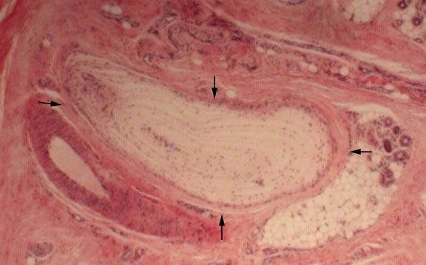
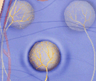
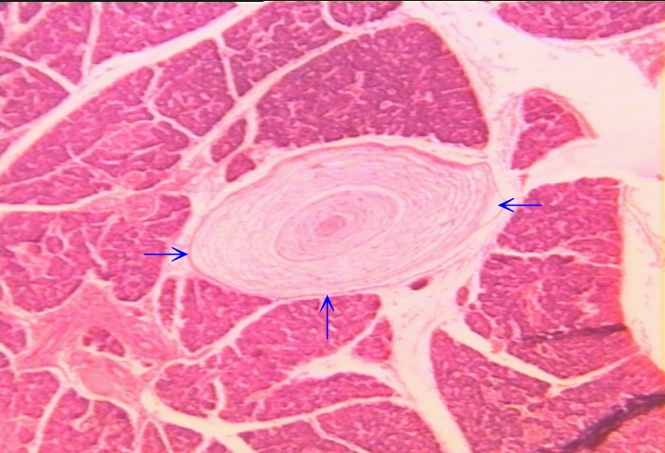
Appendages of Skin (still on pg. 123) Continued
Receptors
Meissners Corpuscle – near surface, light touch
Pacinian Corpuscle – deep in dermis, pressure
Krauses End Bulbs – sense cold
Organ of Ruffini – sense heat
Nerve Endings – sense pain

Slide 10
Appendages of Skin (still on pg. 123) Continued
Nails
Produced in the epidermis
Nail Body – visible
Root – hidden
Cuticle – hides root
Lanula – near root, “half-moon”

Slide 11
Appendages of Skin (still on pg. 123) Continued
Glands
Sweat or Sudoriferous Glands
3 mill plus, produce 12l every 24 hours
Eccrine – numerous and important in producing sweat, eliminating waste and regulating body temp.
Apocrine – in armpits and genitals, produce thicker milky secretions, susceptible to bacterial contamination.
Sebaceous – produces oil for hair and skin, increases during adolescence, clogged ducts = white heads, when aged and darkened = black head.
Acne – sebaceous ducts filled with cells and sebum

