Slide 1
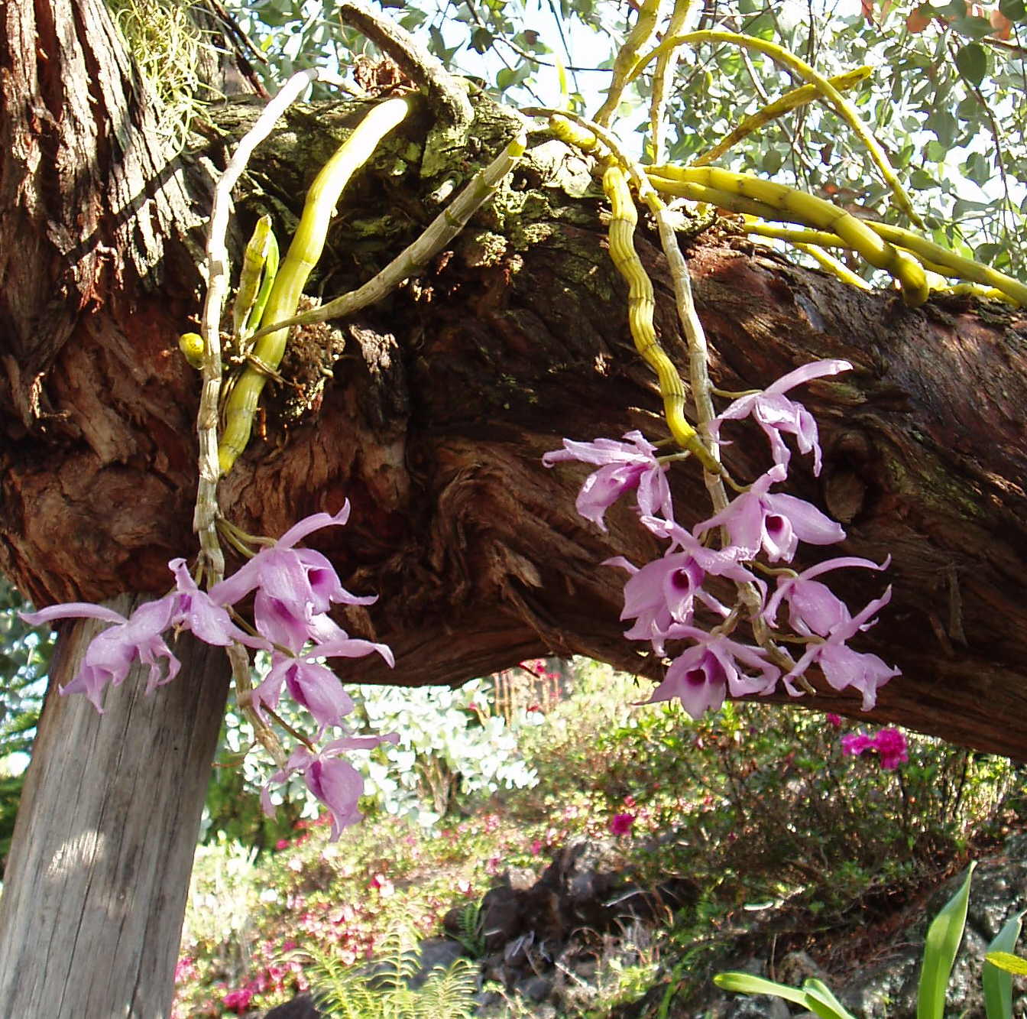
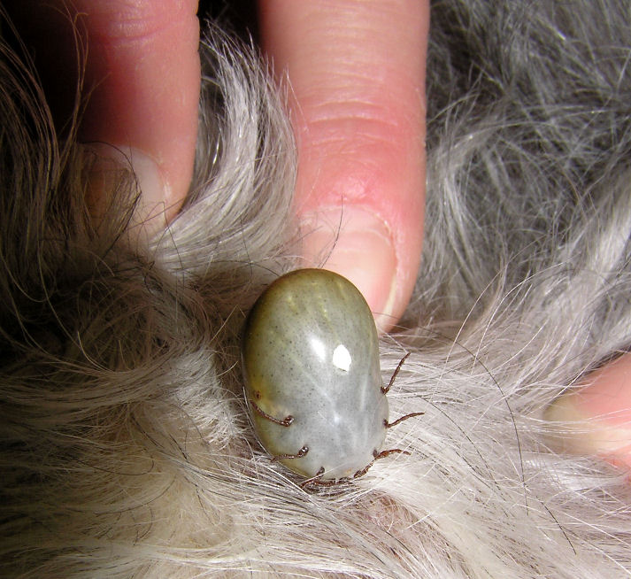
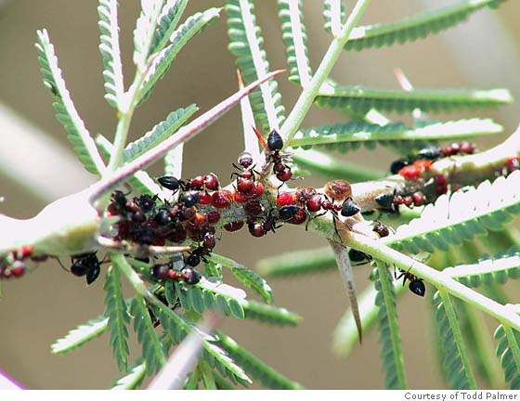
Orchids and trees
Ticks and dogs
Ants and acacia trees

Slide 2
Symbiosis
Take out your journals and copy down the “I Can” statement for #6 in your Electronic Journals.
Ecology Unit
Chapter 2

Slide 3
Symbiosis
What is symbiosis?
Close and dependent relationship between organisms of different species.
Three types of symbiotic relationships:
Mutualism
Commensalism
Parasitism

Slide 4
Mutualism
Both species benefit
+ + relationship
Example:
Ants and acacia trees:
Ants benefit from the tree’s nectar
Tree benefits from the ants’ protection

Slide 5
Commensalism
One species benefits and the other species is not harmed or benefited
+ , 0
relationship
Example:
Orchid and tree:
Orchid benefits from habitat in tree
Tree is not affected

Slide 6
Habitat and Niche
Habitat = place where an organism lives out it’s life.
Niche = role or position a species has in it’s environment (or habitat). Includes all interactions both abiotic and biotic.
Example from previous slide = The niche of the tree is to provide habitat to the orchid. But the tree may also provide such things as food and shade.

Slide 7
Parasitism
One species benefits and the other species is harmed
+ - relationship
Example:
Tick and dog:
Tick benefits from food (blood) in the dog
Dog is harmed from irritation and possible disease

Slide 8
Symbiotic Relationship?
1. Mutualism
2. Commensalism
3. Parasitism

Slide 9
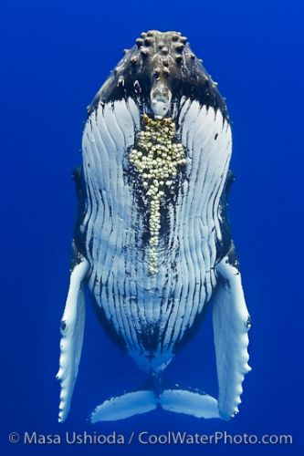
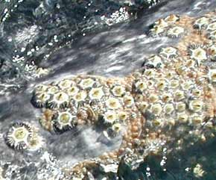
Symbiotic Relationship?
1. Mutualism
2. Commensalism
3. Parasitism

Slide 10
Symbiotic Relationship?
1. Mutualism
2. Commensalism
3. Parasitism

Slide 11
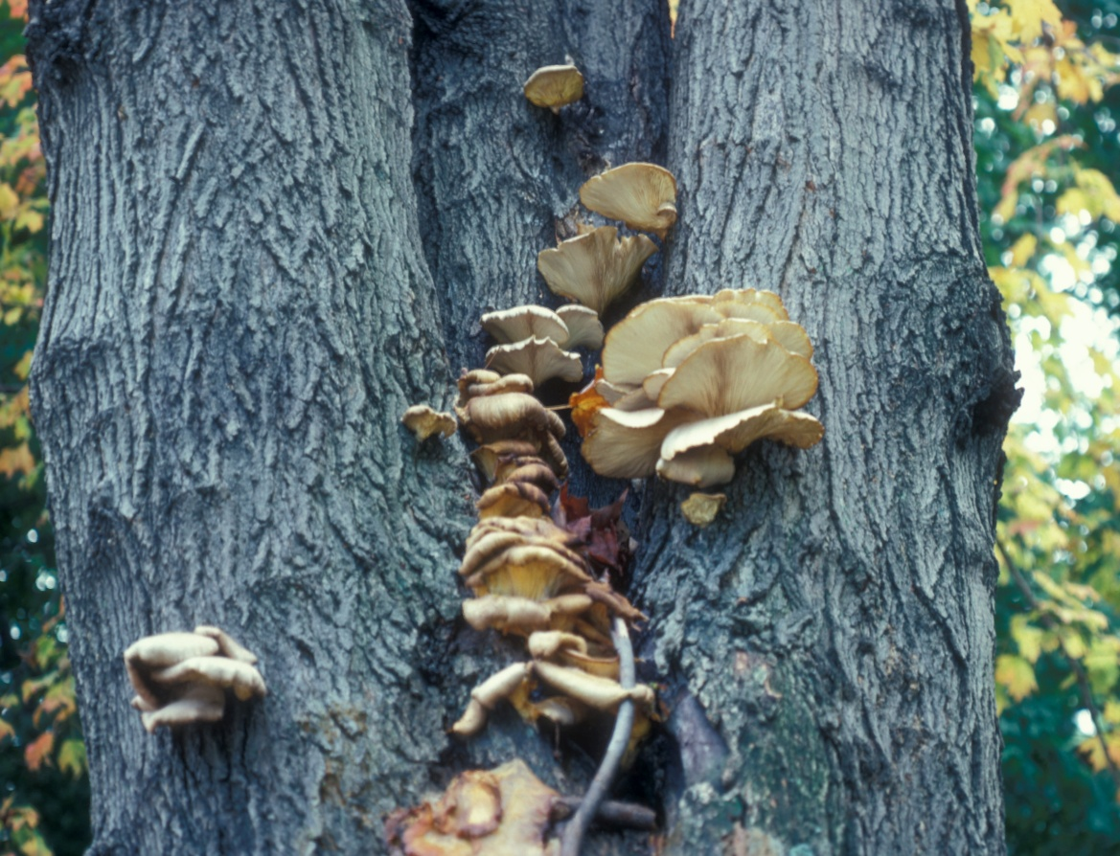
Symbiotic Relationship?
1. Mutualism
2. Commensalism
3. Parasitism

Slide 12
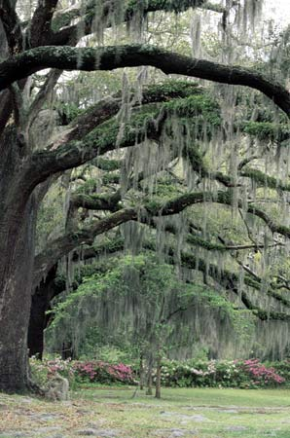
Symbiotic Relationship?
1. Mutualism
2. Commensalism
3. Parasitism
Notes:
Habitat and niche

Slide 13
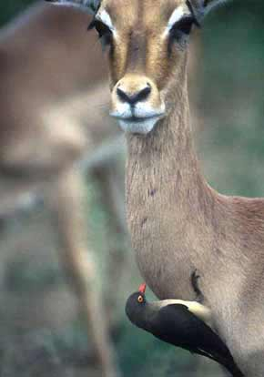
Why do organisms live in symbiotic relationships?
For food
Resources
Habitat
Protection
Transportation
Cleaning
http://www.morning-earth.org/Graphic-E/Interliv-Two.html

Slide 14
http://www.youtube.com/watch?v=uxVMeLWzB_o
http://www.youtube.com/watch?v=xNm7dg3BiyU&feature=related
http://www.youtube.com/watch?feature=player_profilepage&v=tnvbVIcZZHc
http://www.youtube.com/watch?v=vMG-LWyNcAs&feature=related
http://www.youtube.com/watch?v=wXqK5QulbJ8&feature=BFa&list=PLF0BFBE269796D013&lf=rellist
http://www.youtube.com/watch?v=0owHFW_frTE&feature=BFa&list=PLF0BFBE269796D013&lf=rellist

